Slide 1

COMPREHNSIVE DIGITAL MARKETING FOR:

Slide 2

Team Members:
T. Eswar sai ( TEAM LEADER)
D. Purna Chandra
M. Sanjana
M. Anusha
College:
Dr. Lankapalli Bullayya College
Team Id:
LTVIP2025TMID24174

Slide 3
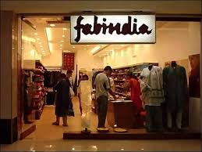
INTRODUCTION:
Fabindia, founded in 1960, is India’s leading retail brand for handcrafted products. It connects rural artisans with urban markets, offering ethnic apparel, home decor, and organic foods made with traditional techniques. Committed to sustainability, it empowers artisans while preserving India’s rich craft heritage.

Slide 4
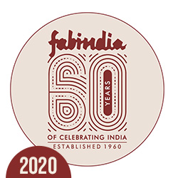
MISSION & VISION:
Fabindia's mission is to celebrate India's rich artisanal heritage by creating sustainable employment for rural craftsmen while offering high-quality, handcrafted products. Its vision is to be a globally recognized brand that promotes traditional craftsmanship, ethical production, and a deep connection between artisans and consumers.

Slide 5
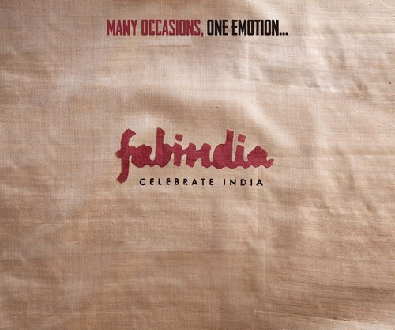
UNIQUE SELLING PROPOSITION:
Fabindia stands out with its ethically sourced, handcrafted products that blend traditional craftsmanship with modern lifestyles. It offers natural, sustainable goods while empowering rural artisans and preserving cultural heritage. This commitment to authenticity, ethical sourcing, and social impact sets Fabindia apart from mass-produced brands.

Slide 6
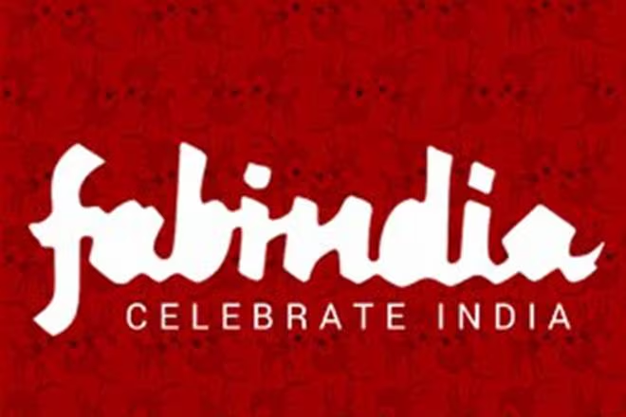
BRAND TAGLINE:
Fabindia’s tagline, "Celebrate India," embodies its commitment to honoring India’s rich artisanal heritage. It reflects pride, festivity, and appreciation for traditional craftsmanship, sustainable fashion, and ethical sourcing. The phrase resonates with conscious consumers, reinforcing Fabindia’s blend of tradition and modernity while promoting rural empowerment.

Slide 7



COMPETITOR ANALYSIS
Manyavar: High-quality ethnic wear blending tradition with modernity, backed by celebrity endorsements and a diverse product range for celebratory occasions.
Aza Fashions: A premier multi-designer platform offering curated luxury Indian fashion, connecting top designers with global customers.
Nestasia: Contemporary home decor with a mix of modern minimalism, eclectic charm, and timeless designs catering to diverse tastes.

Slide 8
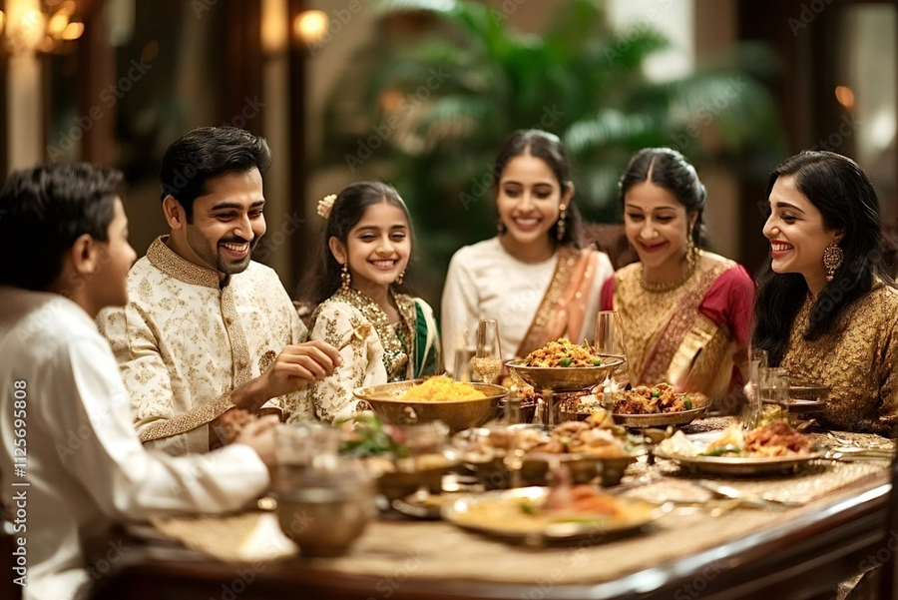
BUYER’S/AUDIENCE PERSONA
Fabindia buyers are ethically conscious, mid-to-high-income individuals who value handcrafted, sustainable products. They seek quality, authenticity, and a blend of traditional aesthetics with contemporary design, connecting with India’s heritage through apparel, home decor, and organic goods.

Slide 9

SEO AUDIT
Technical SEO: Ensuring mobile-friendliness, fast loading speeds, proper crawlability, and HTTPS security.
On-Page SEO: Optimizing keywords, high-quality content, image alt text, and internal linking to improve visibility.
Off-Page SEO: Strengthening the backlink profile and optimizing Google My Business for local SEO, ensuring consistent NAP details.

Slide 10

SEO AUDIT
User Experience (UX): Enhance website navigation and analyze engagement metrics like bounce rate and time on site.
E-commerce SEO: Optimizing product pages and shopping ads for better conversions. Given Fabindia’s focus on handcrafted products, storytelling through content is crucial. Their strong brand presence should be leveraged in SEO, and local SEO is vital for driving foot traffic to physical stores. By refining these

Slide 11
KEYWORD RESEARCH
KEYWORDS | SEARCH VOLUME | TRAFFIC PERCENTAGE | URL | COST PER CLICK (CPC) IN $
Fab India | 74,000 | 10.09% | www.fabindia.com/ | 0.52$
Fab India near me | 60,500 | 8.25% | www.fabindia.com/ | 1.032$
Fabindia Online | 18,100 | 2.46% | www.fabindia.com/ | 2.85$
Fabindia Gift | 2,46,000 | 2.09% | www.fabindia.com/collection/gifting-ideas-home-living | 0.92$
Short Kurti for Women | 4,50,000 | 1.91% | www.fabindia.com/clothing/women-kurtis | 1.04$
Sari | 1,65,000 | 1.12% | www.fabindia.com/clothing/women-saris-blouses | 1.24$
Kurta for Men | 5,50,000 | 0.84% | www.fabindia.com/clothing/men-kurtas | 1.94$
Skirts for Women | 1,65,000 | 0.84% | www.fabindia.com/clothing/women-skirts-shorts | 0.29$

Slide 12
BACKLINK ANALYTICS
Backlinks: Approximately 950.88k Referring domains: Around 5.83k NOTE: these numbers can fluctuate over time. For the most accurate and up to date information, I recommend using a tool like SEMRUSH, AHREFS, or MOZ
REFERRING DOMAINS | BACKLINKS | MONTHLY VISITS | TRAFFIC | TRAFFIC COST
5.83K | 950.88K | 617.18K | 586.3K | $204.6K

Slide 13
ORGANIC AND PAID TRAFFIC

Slide 14

ON PAGE OPTIMIZATION
Keyword Optimization: Use relevant keywords like handcrafted cotton kurtas in the title
tags, meta descriptions, and headers.
Content Quality: Create engaging product descriptions highlighting craftsmanship
(e.g., “Handwoven Chanderi silk with traditional block prints”).
Image Optimization: Add descriptive alt text (e.g., Hand-embroidered jute tote bag)
and compress images for faster loading.

Slide 15

ON PAGE OPTIMIZATION
Internal Linking: Link related products (e.g., Pair this linen kurta with our organic cotton dupatta).
Structured Data: Implement schema markup for products, reviews, and FAQs to enhance search visibility.

Slide 16
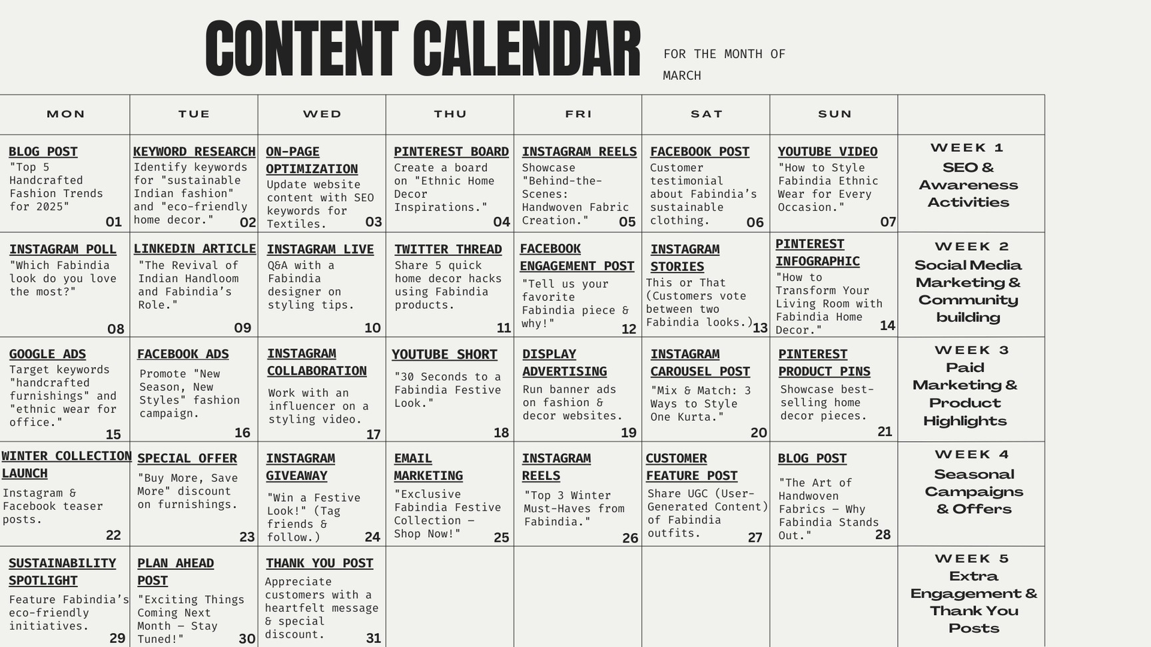
CONTENT IDEA GENERATION

Slide 17

MARKETING STRATEGIES
Digital Marketing: Optimize product pages and blogs around keywords like handcrafted sarees and organic cotton kurtas. Showcase artisans and craftsmanship through Instagram Reels and YouTube videos.
E-commerce & Paid Ads: Run targeted ads for specific collections. Partner with fashion and sustainability influencers to promote products.

Slide 18
MARKETING STRATEGIES
Local & Offline Marketing: Organize workshops on handloom weaving and sustainable Fashion. Ensure accurate store listings and positive customer reviews.
Loyalty & Engagement: Offer exclusive discounts and early access to collections. Send personalized offers and festival promotions.

Slide 19
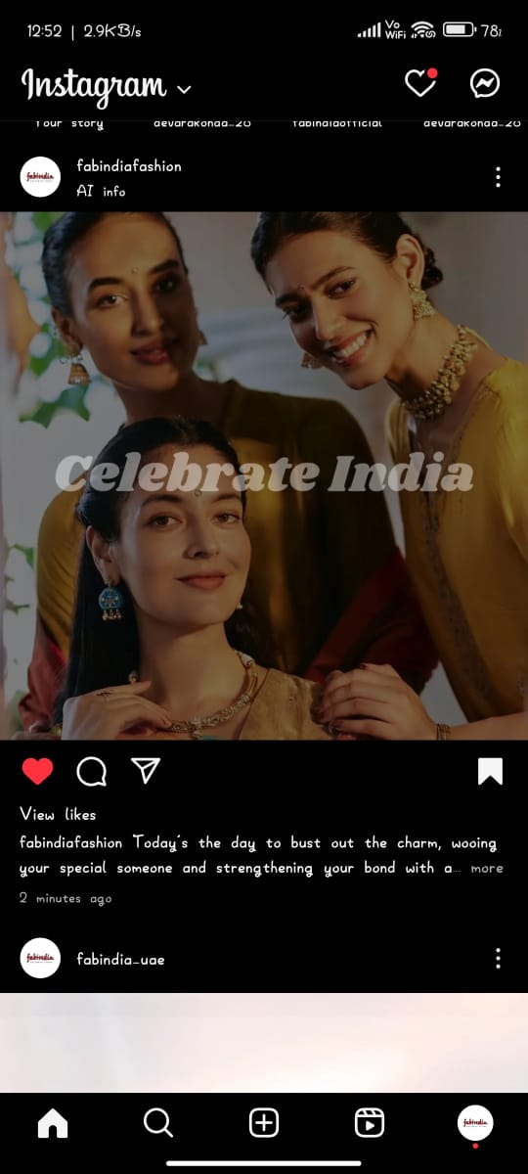
CONTENT CREATION AND CURATION
INSTAGRAM POST
https://www.instagram.com/p/DHAp6wmSpuj/?igsh=OWo5cnpxaHE1bTd3

Slide 20
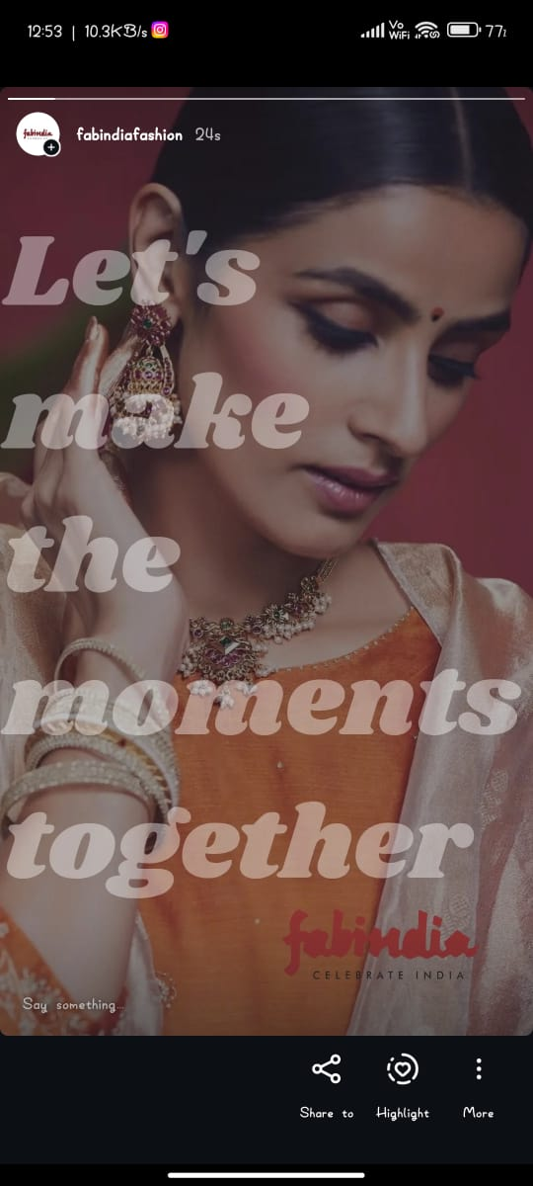
INSTAGRAM STORY
https://www.instagram.com/stories/fabindiafashion/3585050906670509067?igsh=MWdmZ2p2Y2o4MHg2Ng==

Slide 21
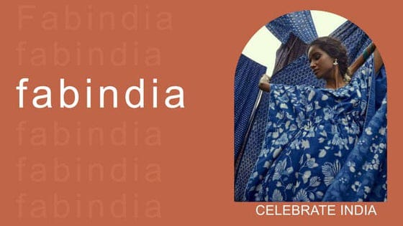
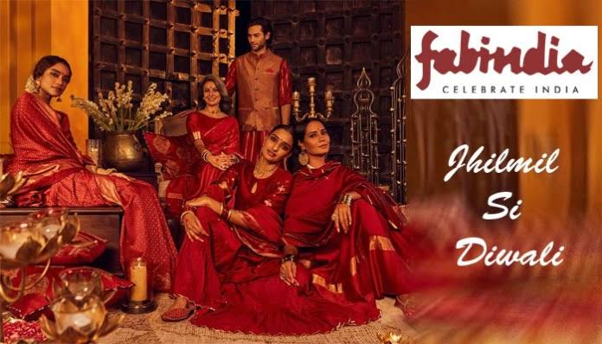
SOCIAL MEDIA AD. CAMPAIGNS

Slide 22
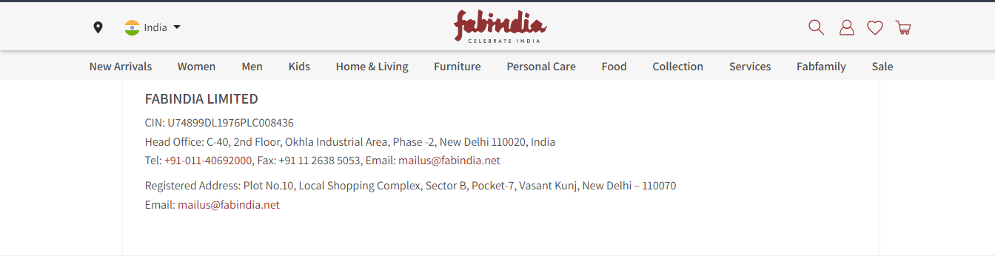
EMAIL AD. CAMPAIGNS

Slide 23

CONCLUSION
FabIndia has established itself as a leading Indian retail brand that seamlessly blends traditional craftsmanship with contemporary designs. By promoting sustainable and ethically sourced products, the company has empowered artisans and preserved India’s rich heritage. Its diverse range of apparel, home décor, and organic products appeals to both domestic and global consumers. Despite facing competition and evolving market trends, FabIndia continues to thrive by adapting to consumer preferences while maintaining its core values of authenticity and quality. With a strong commitment to sustainability and social responsibility, FabIndia remains a trusted brand that bridges the gap between tradition and modernity.

Slide 24


